Slide 1
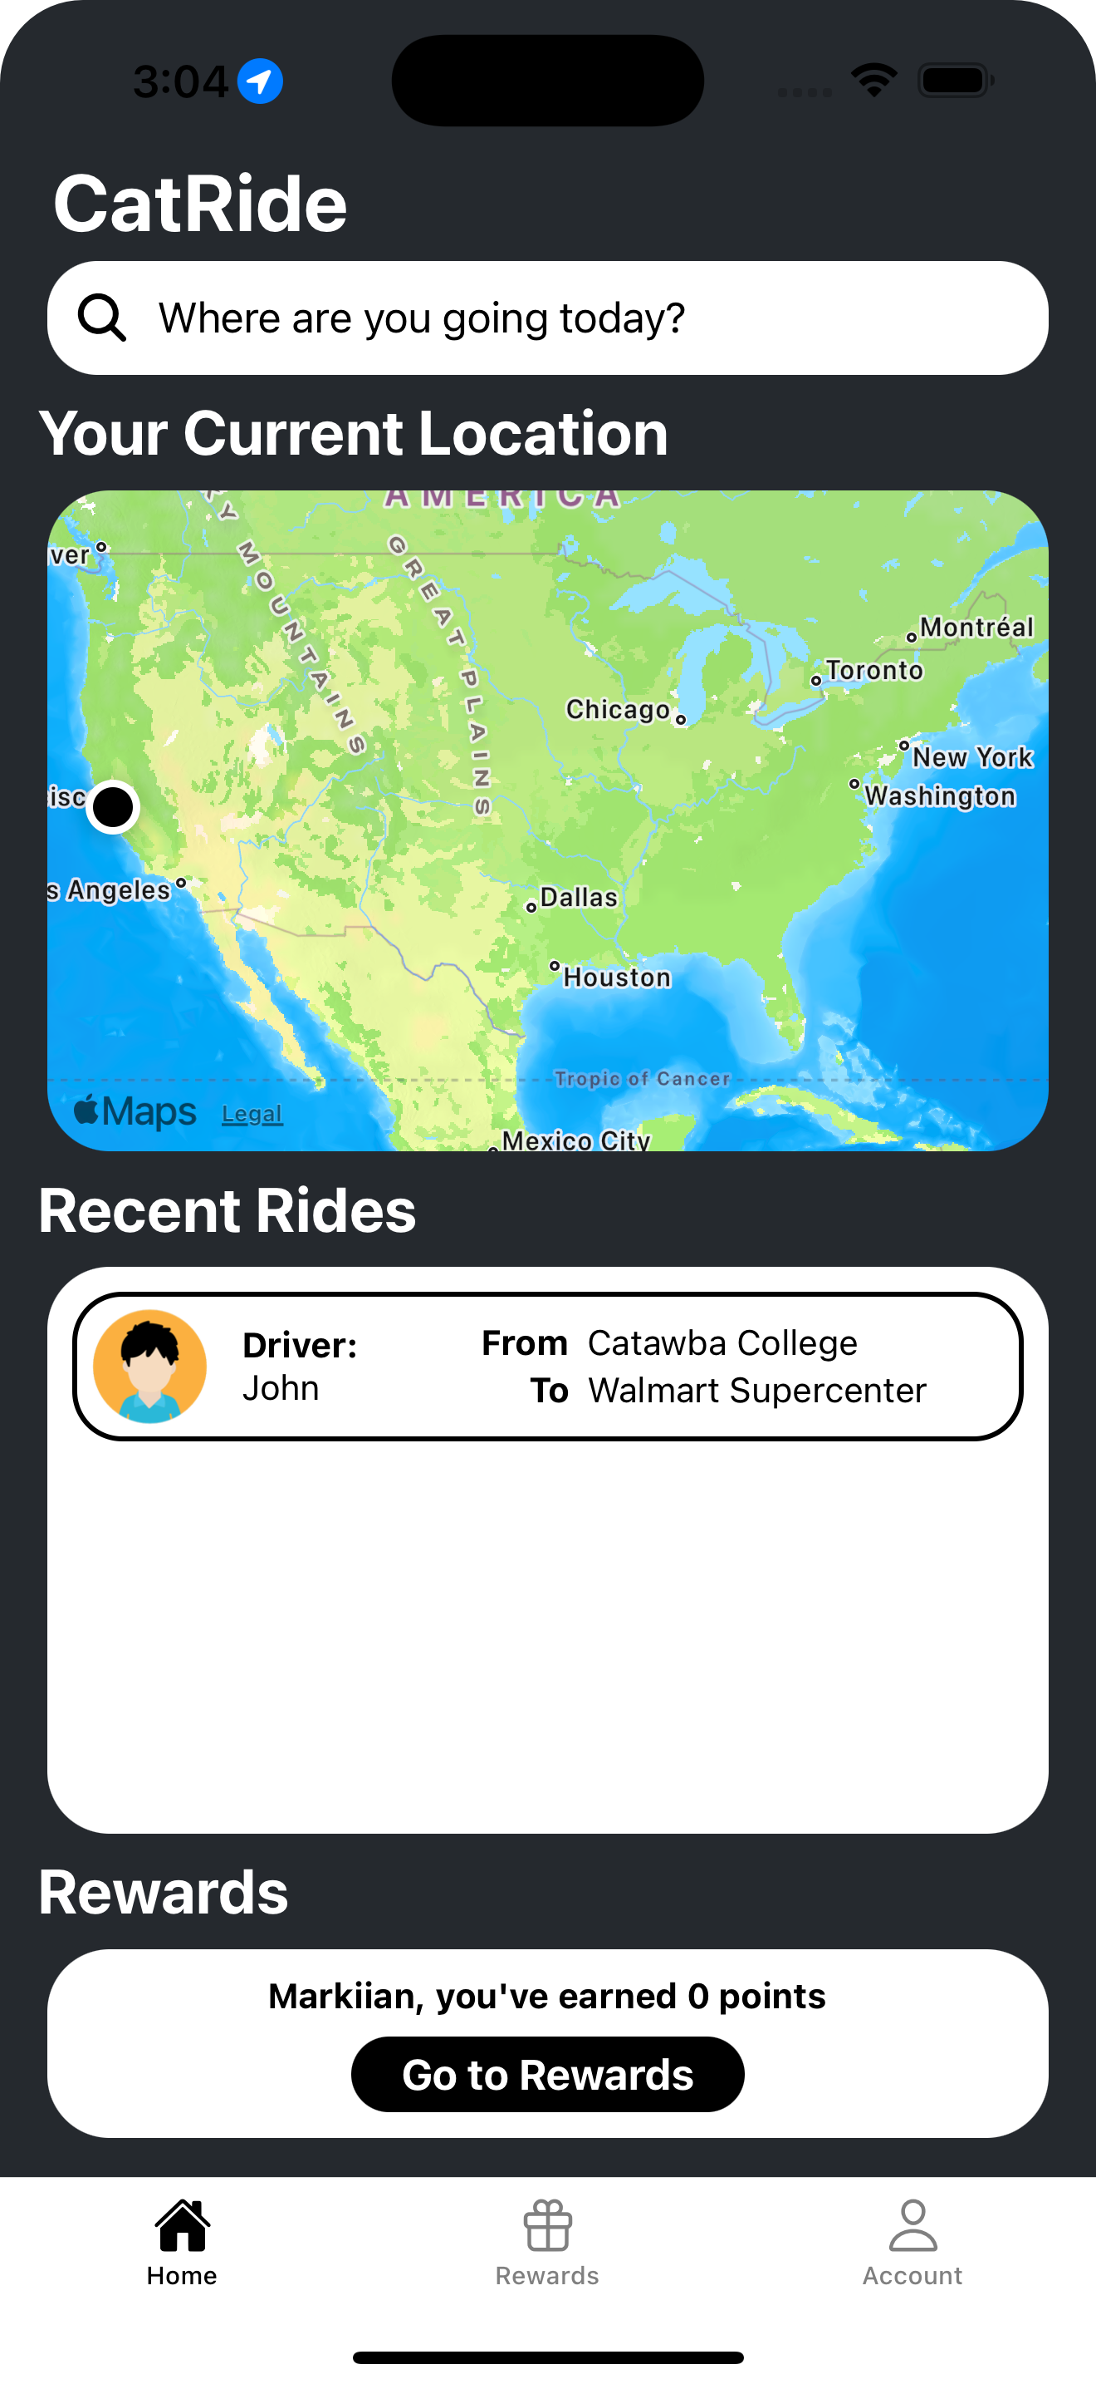
CatRide
Your free student ride around Salisbury
Author: Markiian Ivaniv
CatRide is a free Uber-style ride-sharing app designed exclusively for Catawba College students, providing safe and sustainable transportation on and around campus.

Slide 2

Concept & Inspiration
The idea for CatRide came from a conversation with Dr. Lee Ball, the Vice President of Sustainability at Catawba College. He shared the college’s vision to purchase electric vehicles and offer paid driving opportunities to students, making transportation both eco-friendly and accessible. The app addresses two key needs: students without cars often struggle with mobility, and many students seek flexible on-campus jobs. Our target users are Catawba students—both passengers and student drivers.
While the idea shares similarities with Uber, CatRide is unique in being completely free for students and operated by students. That local, student-first focus is what makes it special.

Slide 3
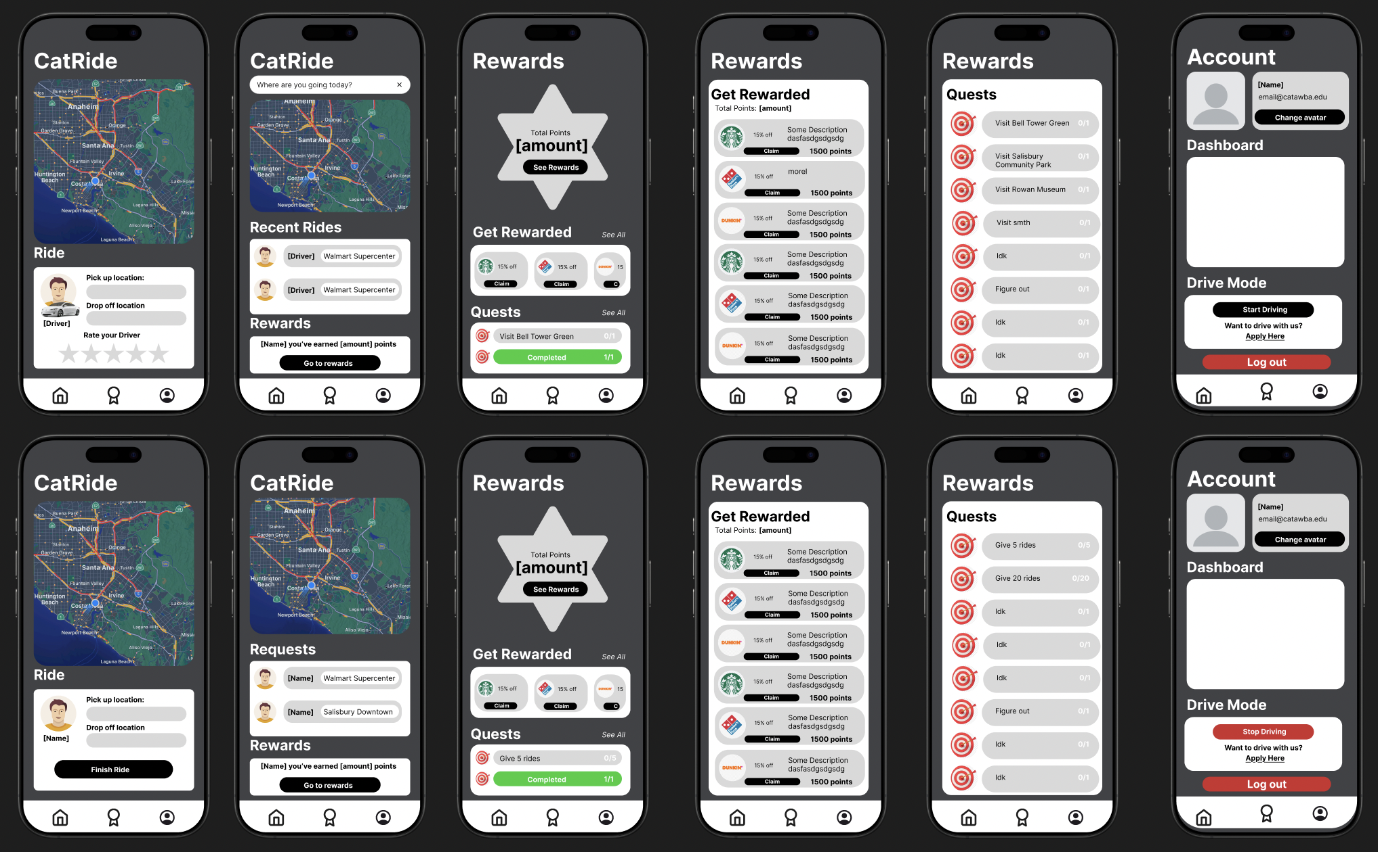
Wireframe & Design Process
All designs for CatRide were created by me from scratch. I focused on simplicity, clarity, and a smooth user experience.
The navigation is straightforward, with tabs for Home, Rides, and Profile. I chose a clean color scheme aligned with Catawba’s branding and ensured the design was accessible across different devices and screen sizes.

Slide 4
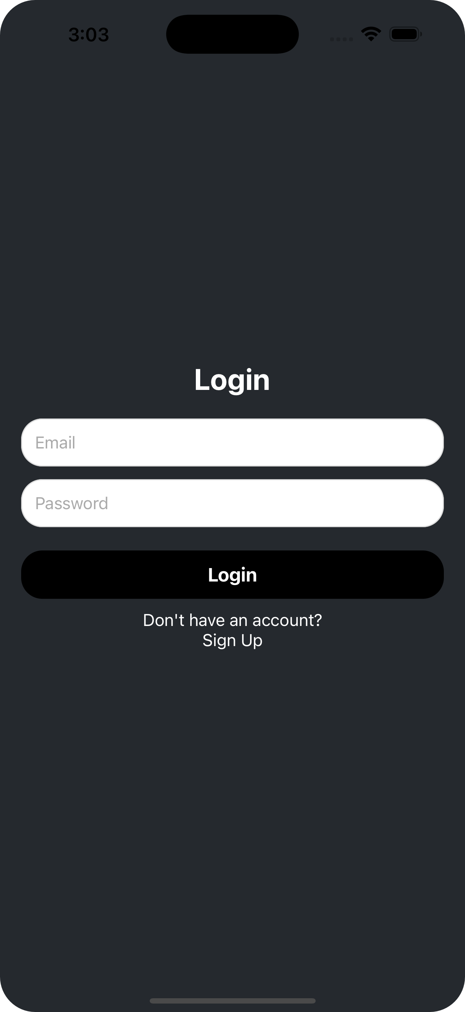
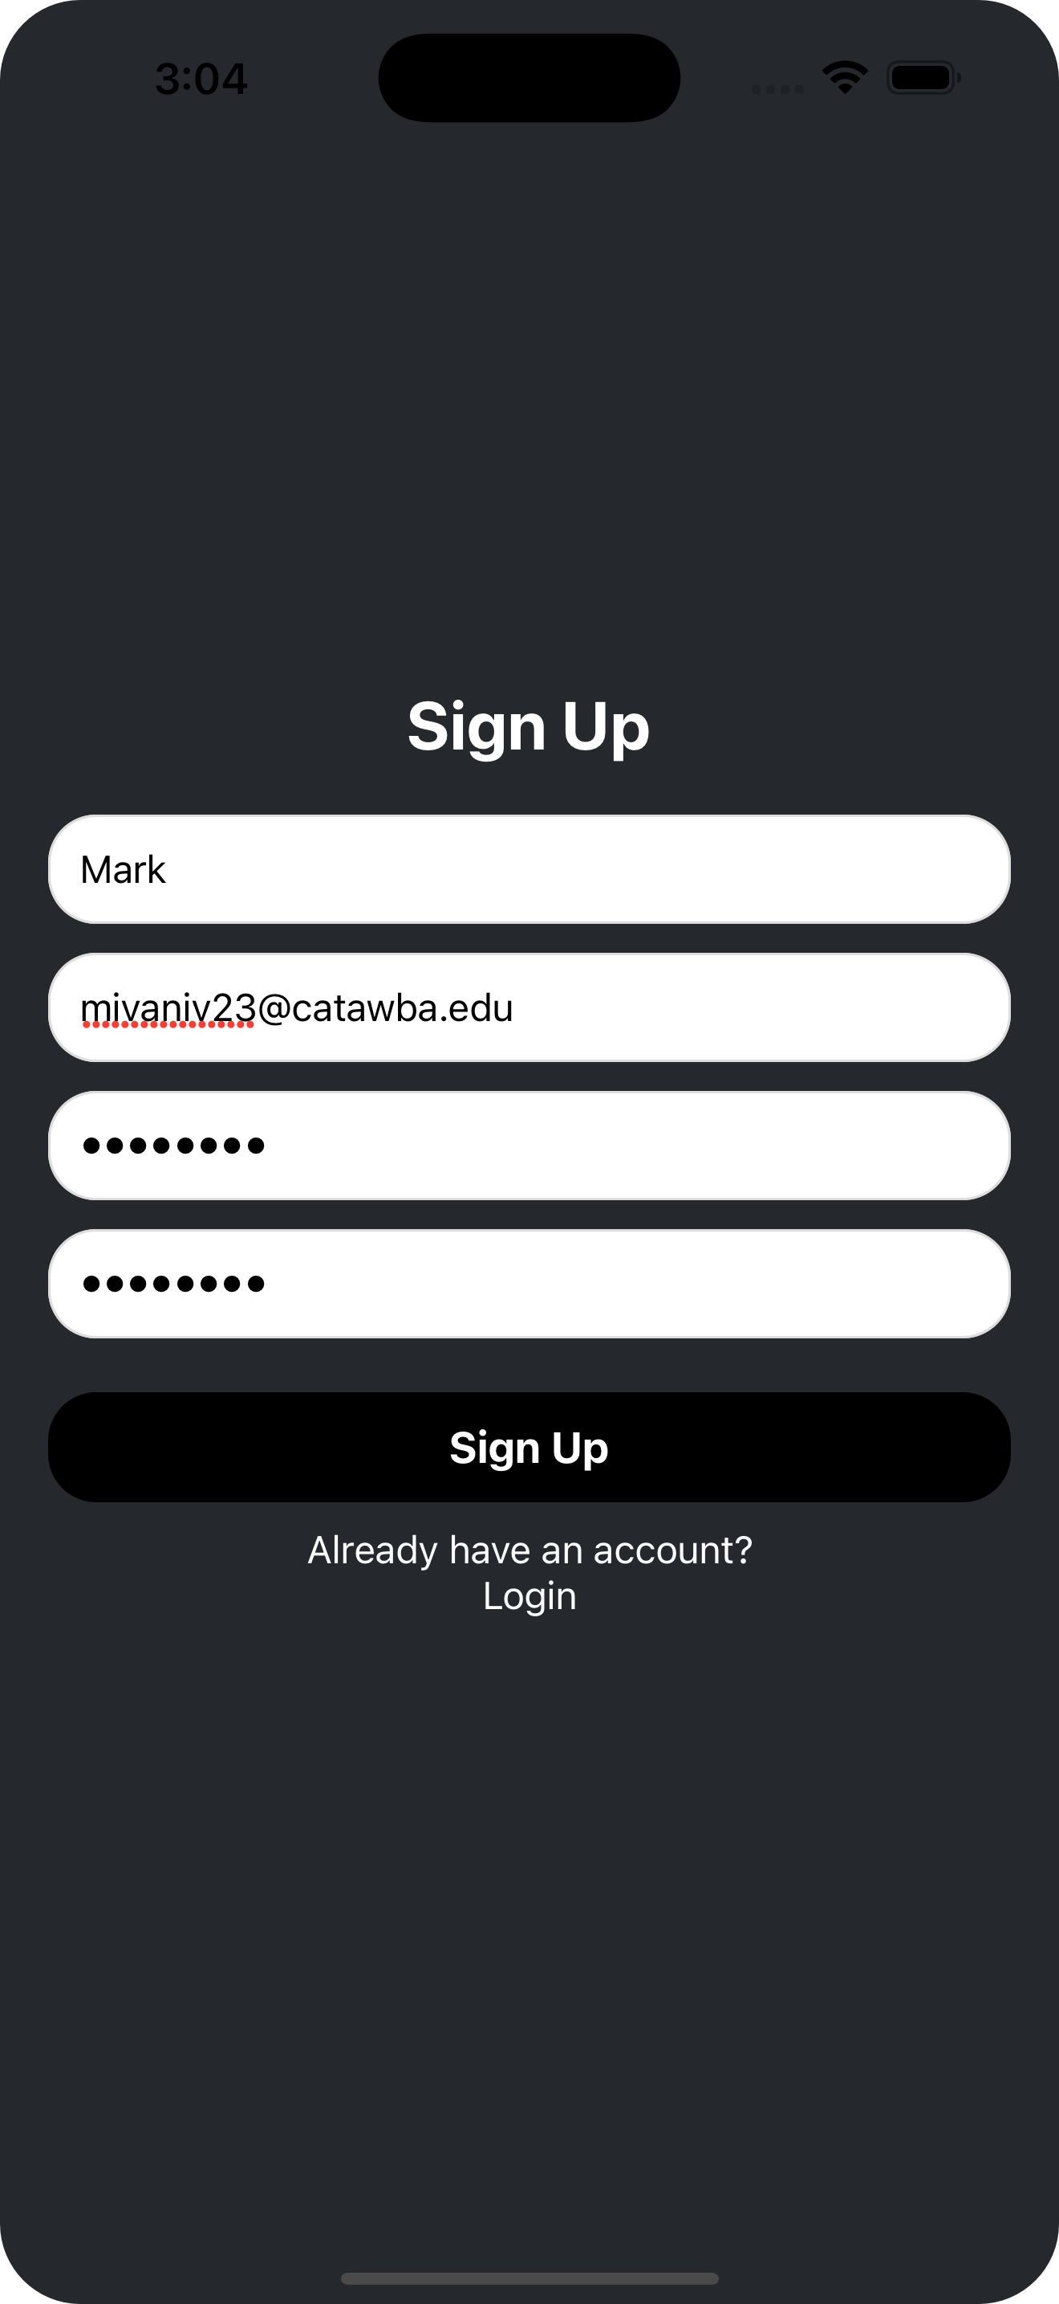
Development Highlights
I built CatRide using React Native and Expo, and used Appwrite for authentication and database management. Key implemented features include:
Login/Signup system connected to Appwrite's database
Some features I didn’t have time to finish include:
A full ride booking system
A driver mode toggle that changes the interface when a student switches roles
These features are planned for future updates.

Slide 5

Demo

Slide 6

Testing & Debugging
Testing started off rough—I was using a limited cloud instance of Appwrite that only allowed 10 database requests per hour, which made debugging extremely difficult. Once I switched to hosting Appwrite myself, testing became much smoother, and I was able to quickly debug and fix issues with login and signup. This experience taught me a lot about real-world testing constraints and backend debugging.

Slide 7
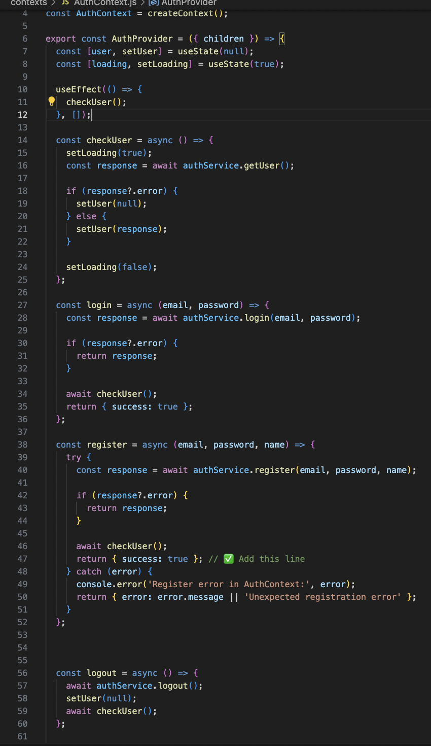
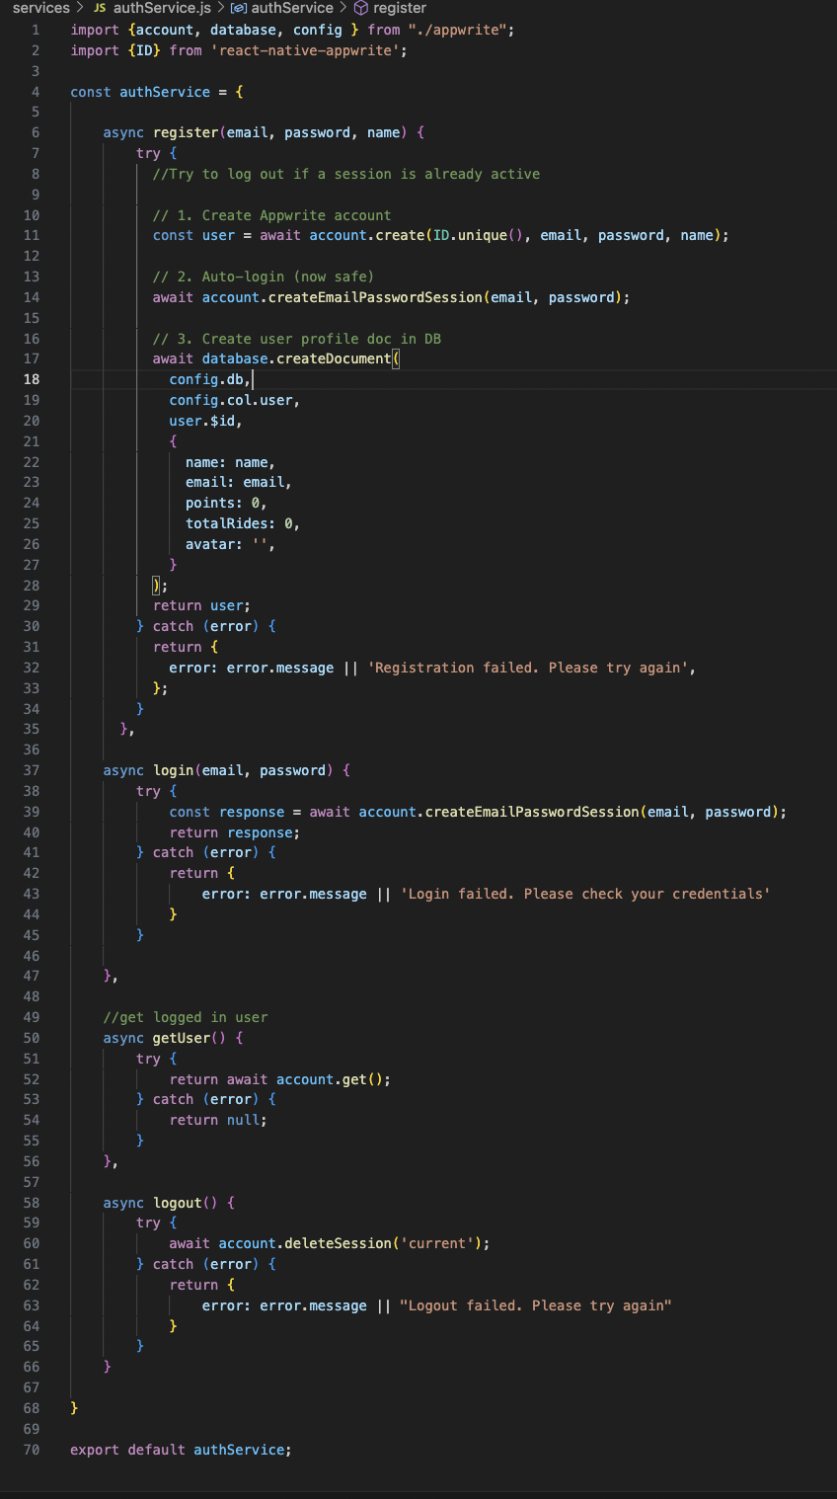
Code Spotlight
One important code snippet is the authentication logic using Appwrite's SDK. It securely handles signup, login, and session management. This part was critical to ensure user data is protected and properly connected to their profile.

Slide 8




Challenges & Lessons Learned
The biggest challenge was learning an entirely new tech stack in just one month—React Native, JavaScript, Appwrite and Expo were all new to me. A simple notes app tutorial gave me the foundation I needed, and from there, I built everything else on my own. This process taught me how to learn fast, break big problems into smaller ones, and adapt quickly to new languages and tools.

Slide 9

Future Plans
I plan to complete the ride booking system and driver mode toggle this summer. Other future improvements include:
Email verification
Customizable avatars stored in the database
Light/Dark theme toggle
Once the app is complete, I plan to release it on Android first since it’s free to publish. If Catawba can support me in covering the Apple Developer fee, I’d love to make it available on iOS as well.

Slide 10

References & Credits
Special Thanks:
ChatGPT (OpenAI) – for writing assistance and structure refinement
Dr. Lee Ball – for the initial inspiration and sustainability insight
Catawba College – for supporting student-led innovation
Documentation & Tools:
React Native Documentation
Expo Documentation
JavaScript Documentation (MDN)
Tutorial Video – React Native Notes App
Gitpod Classic

Slide 11
Thank You!

